Slide 1
Business
Monitor
Q4 2014

Slide 2
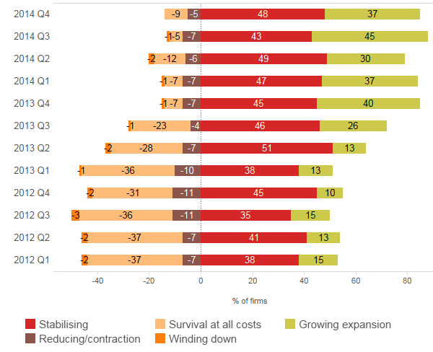
“85% of firms either stable or growing...”
Business position
Which of the following best describes the current position of your business?

Slide 3
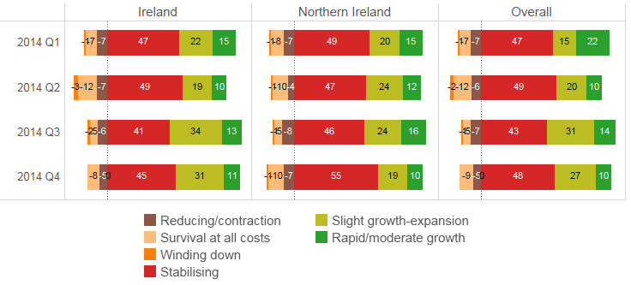
“...growth is stronger in Ireland...”
Business position by location
Which of the following best describes the current position of your business?

Slide 4
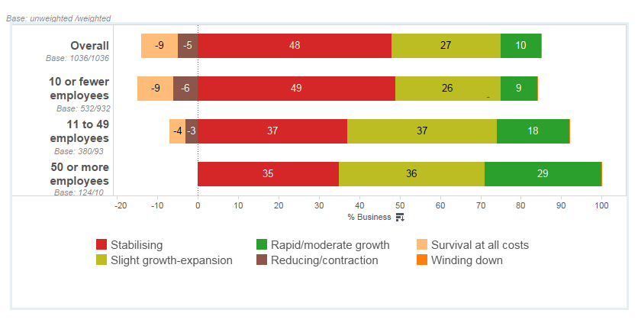
“...larger firms continue to grow more rapidly...”
Business position by firm size
Which of the following best describes the current position of your business?

Slide 5
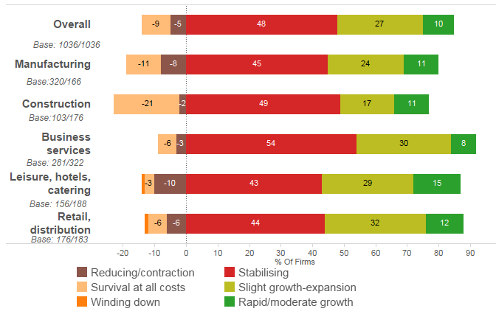
“...stability rather than growth in most sectors...retail and leisure outperforming...”
Business position by sector
Which of the following best describes the current position of your business?

Slide 6
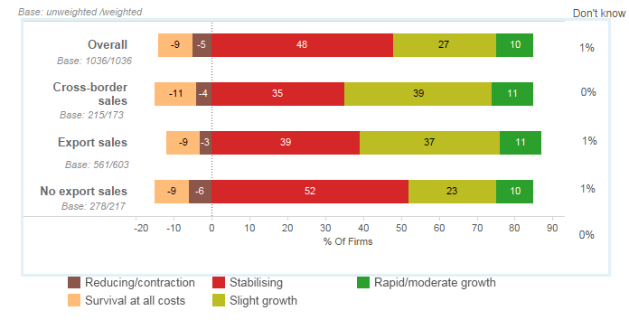
“...business involved in cross-border trade or exporting off the island more likely to grow...”
Business position by export activity
Which of the following best describes the current position of your business?

Slide 7
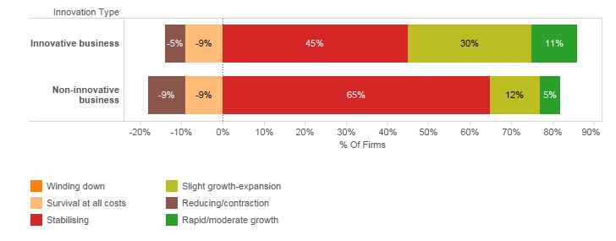
“...similarly innovative businesses much more likely to grow...”
Business position by innovation activity
Which of the following best describes the current position of your business?

Slide 8
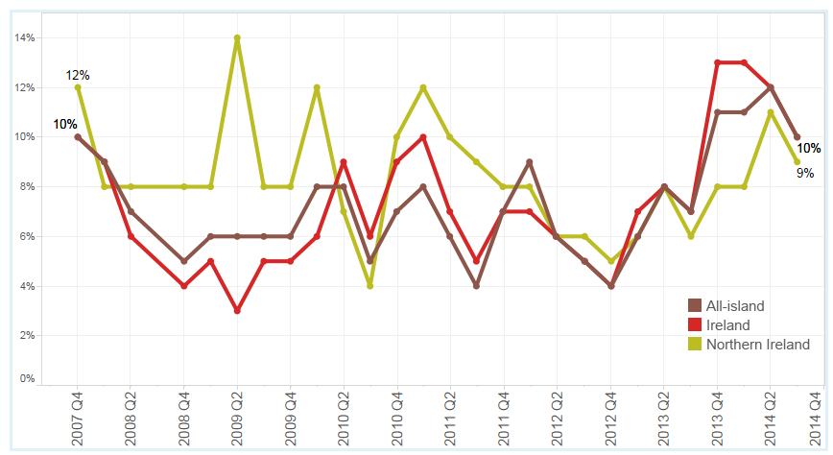
“Slight fall from last quarter in numbers of firms increasing employment...”
Businesses increasing employment
Businesses (%) reporting an increase in employment levels
13%
8%

Slide 9
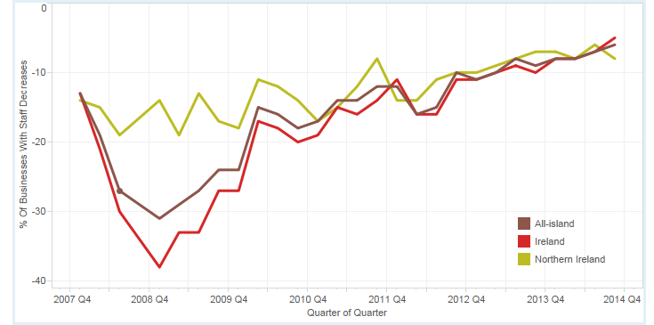
“...however, the long term trend in fewer firms cutting employment is continuing...”
Businesses decreasing employment
Businesses (%) reporting a decrease in employment levels

Slide 10
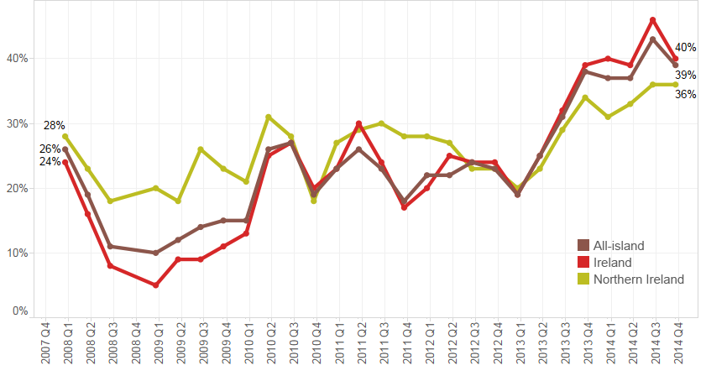
“..also sales performance this quarter less buoyant than in previous..”
Sales performance
Businesses (%) reporting an increase in sales

Slide 11
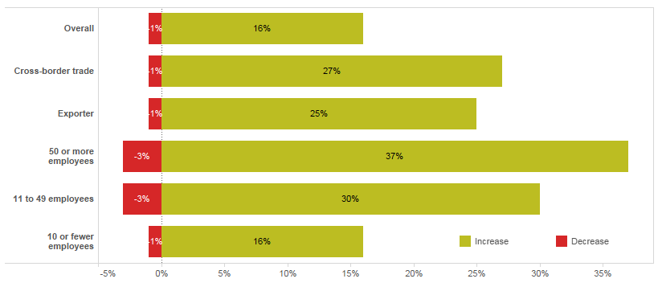
“...exporters and larger firms more optimistic about creating jobs...”
Employment expectations
Do you expect the number of employees to increase or decrease in the next 12 months?

Slide 12
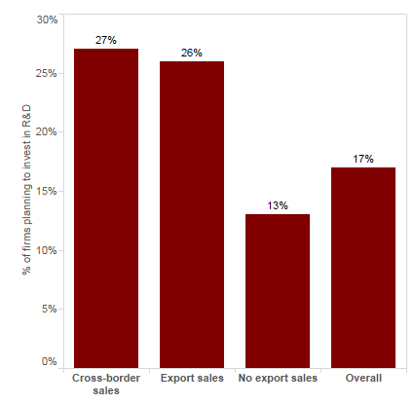
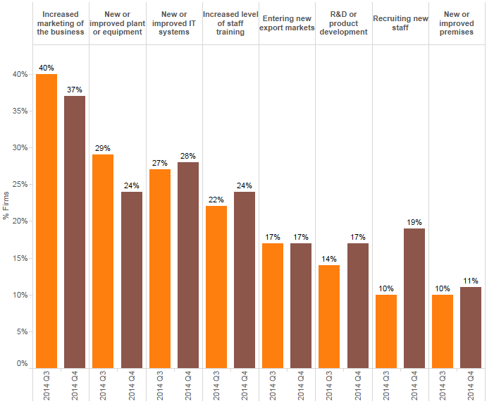
“...cross-border traders and exporters more likely to invest in the next year...”
Investment plans
Exporters and businesses involved in cross-border trade are twice as likely have investment plans for the following:
Recruitment of staff
Entering new markets
Upgrade IT systems and other equipment

Slide 13
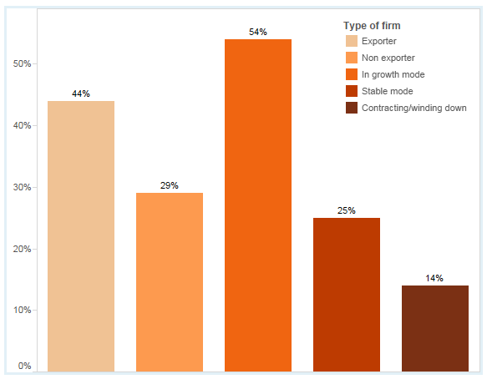
“...too many firms are still not planning ahead...”
Business plans
Does your firm have a business plan or strategy?

Slide 14
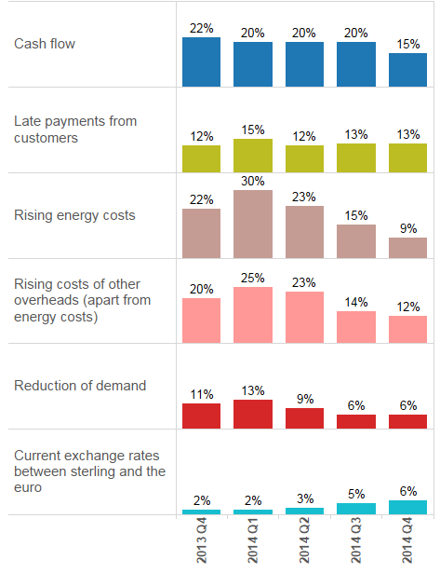
“...big decline in fuel prices having a positive impact...”
Key challenges for businesses
Most of the challenges faced by businesses continue to decline in importance.
Cash flow and late payments are now the issues of most significance for firms across the island.
Energy costs is now affecting two third fewer businesses than at the start of 2014, perhaps influenced by lower fuel prices.
The exchange rate between sterling and the euro remains an issue for a small number of firms but is growing in significance.

Slide 15
Preliminary conclusions...
Stability is embedded with 85% of firms either growing or stable...
Cross-border traders, exporters and innovating firms are more likely to be growing, increasing sales and employment...
Continued volatility in the businesses increasing employment but longer trend decline in the numbers cutting jobs...
Costs pressures remain but less pressing than a year ago while management of credit and debt is a significant issue.

