Slide 1

Business Monitor
Q1 2015

Slide 2
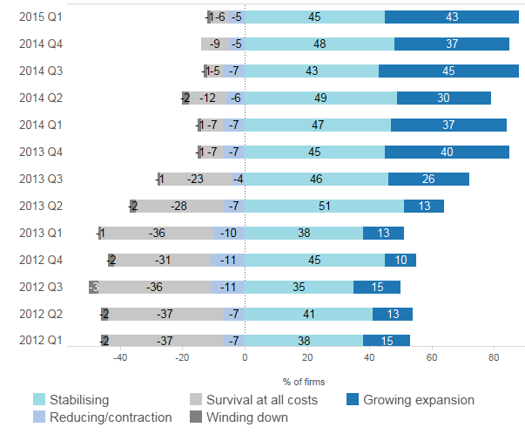
“88% of firms either stable or growing...”
Business position
Which of the following best describes the current position of your business?

Slide 3
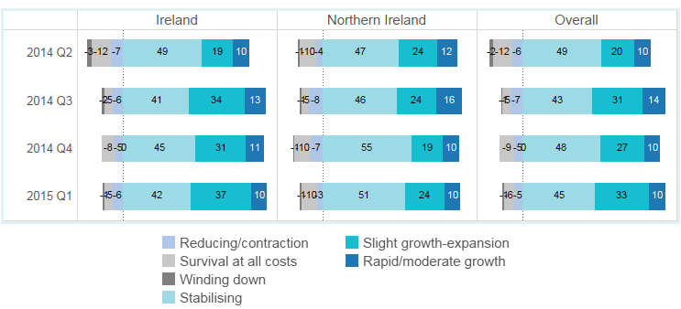
“...growth continues to be stronger in Ireland...”
Business position by location
Which of the following best describes the current position of your business?

Slide 4
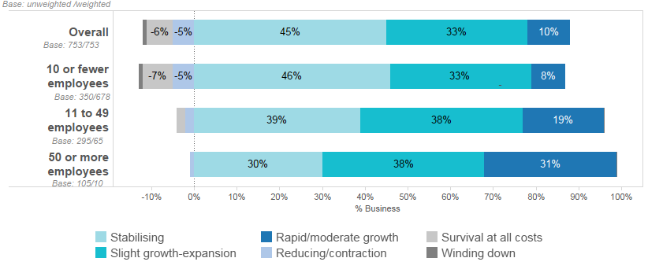
“...growth in larger firms continues to be more rapid then in others...”
Business position by firm size
Which of the following best describes the current position of your business?

Slide 5
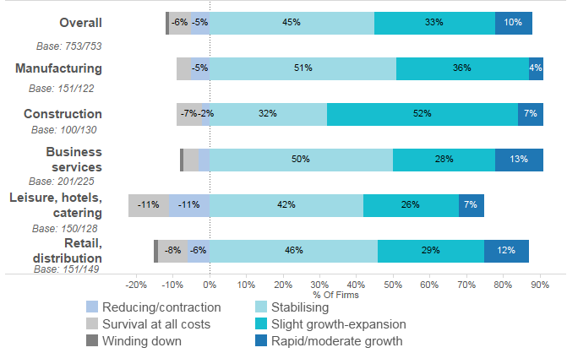
“...growth in most sectors but retail and leisure lagging
this quarter...”
Business position by sector
Which of the following best describes the current position of your business?

Slide 6
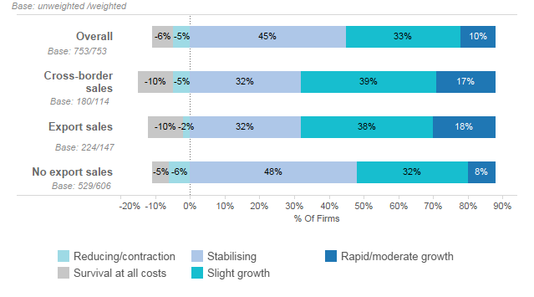
“...businesses involved in cross-border trade or exporting off the island continue to be significantly more likely to grow...”
Business position by export activity
Which of the following best describes the current position of your business?

Slide 7
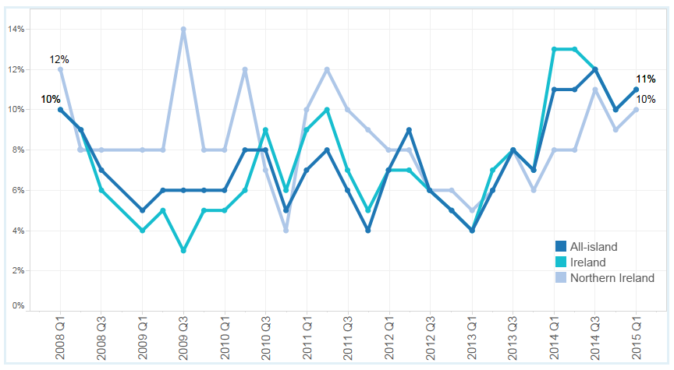
“Small increase this quarter in the numbers of firms increasing employment...”
Businesses increasing employment
Businesses (%) reporting an increase in employment levels

Slide 8
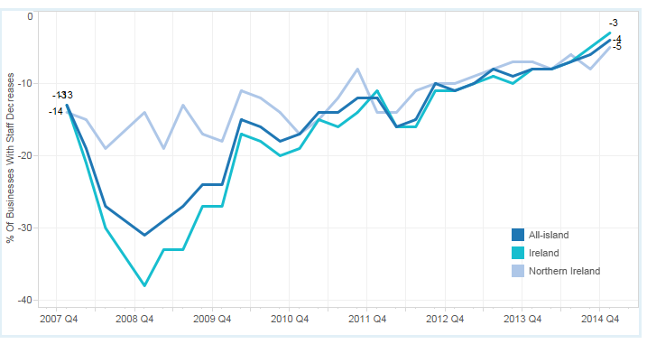
“...and the long term trend in fewer firms cutting employment continues...”
Businesses decreasing employment
Businesses (%) reporting a decrease in employment levels

Slide 9
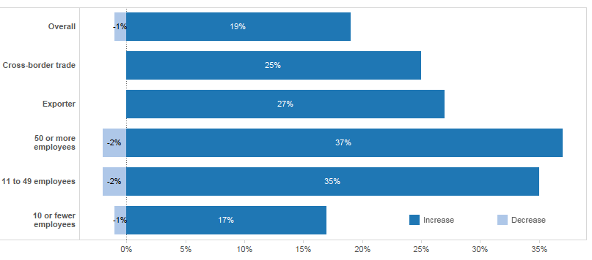
“...growing number of rims expecting to increase employment, particularly exporters and larger firms...”
Employment expectations
Do you expect the number of employees to increase or decrease in the next 12 months?

Slide 10
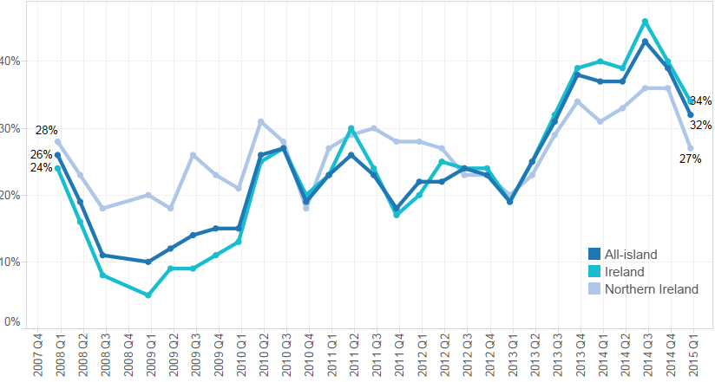
“...sales performance has declined for second quarter in a row...”
Sales performance
Businesses (%) reporting an increase in sales

Slide 11
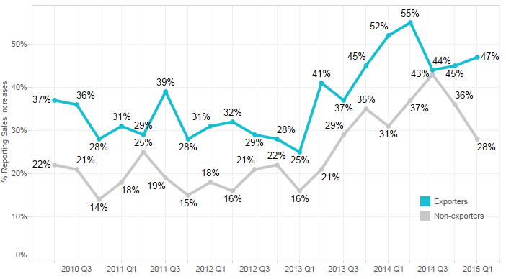
“...although sales performance of exporters outstripping non-exporters...”
Sales performance by exporters and other firms
Businesses (%) reporting an increase in sales

Slide 12
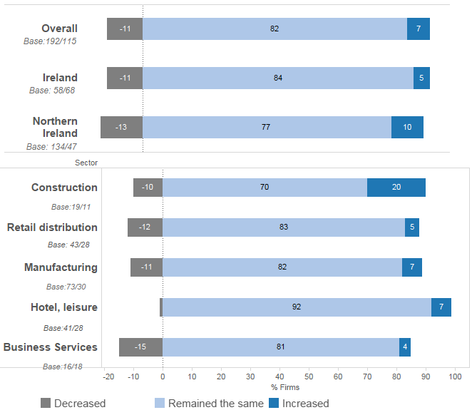
“...however, a cause for concern in the number of businesses seeing a decline in their cross-border sales, due to exchange rate fluctuations...”
Cross-border sales in last year

Slide 13
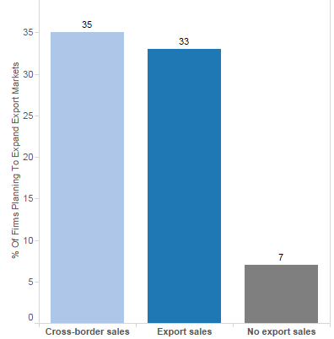
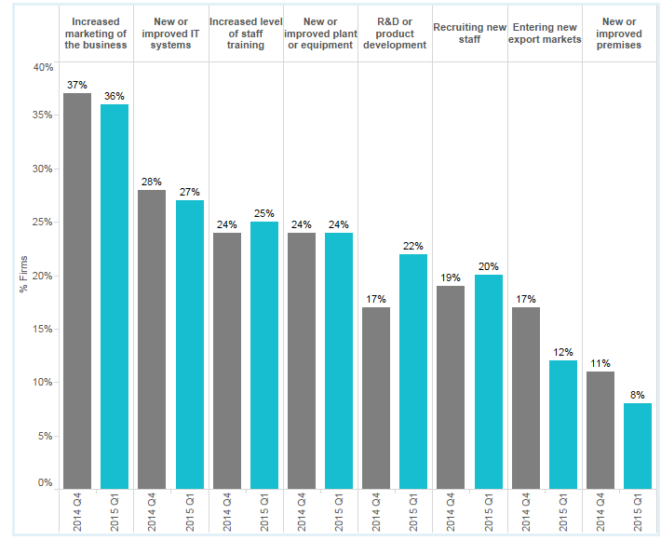
“...majority of firms have plans to invest in the next year, particularly exporters and cross-border traders...”
Investment plans
Exporters and businesses involved in cross-border trade are also twice as likely have investment plans for the following:
Upgrading IT systems
Increasing marketing
R&D or product development

Slide 14
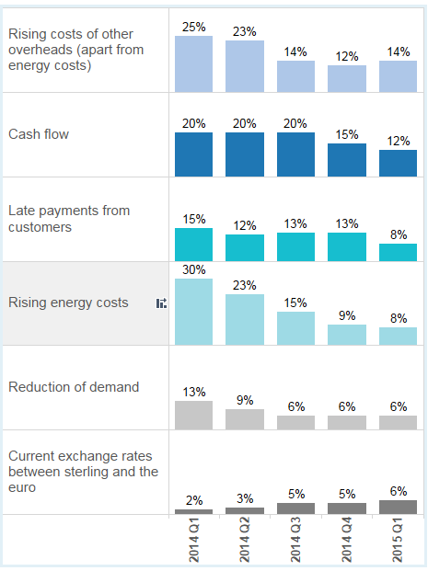
“...recovery impacting on the challenges for businesses...”
Key challenges for businesses
Most of the challenges faced by businesses continue to decline in importance.
Costs of business overheads (including wages) now the leading challenge.
Energy costs now affects a quarter of the number of businesses it did a year ago, showing the impact of lower fuel prices.
The exchange rate between sterling and the euro continues to grow in significance, especially for exporters, but remains an issue for a small number of businesses.

Slide 15
Conclusions...
Recovery is continuing with 88% of firms either stable or growing...
Recovery strongest in Ireland and among firms engaged in exporting or cross-border trade...
Notes of caution in the slight fall in the number of businesses reporting sales increases and in the number of businesses increasing their level of cross-border trade...
...and in the sense that issue (excepting overheads) becoming less of a significant challenge over time.
Cautious optimism reflected in two thirds (68%) having plans to invest in the year ahead...

Slide 16


